Slide 1
Turnstile Junction Orthomode Transducer
An option for EVLA X-Band Receiver
X-Band OMT Design Review Meeting; AOC, Socorro; October1, 2009
Sivasankaran Srikanth, Miles Solatka & Michael Meek
Scientist/Research Engineer Designer Machinist
NTC-CDL

Slide 2
Contents
Introduction
Selection process
Optimization, analysis
Mechanical design
Measurements
Conclusions

Slide 3
Specifications of X-band OMT
Bandwidth 8 to 12 GHz (1.5:1 BW ratio)
Return loss > 25 dB
Insertion loss ≤ 0.2 dB
Crosspolarization ≤ -40 dB
Isolation ≤ -40 dB
Size ??????
Weight ?????

Slide 4
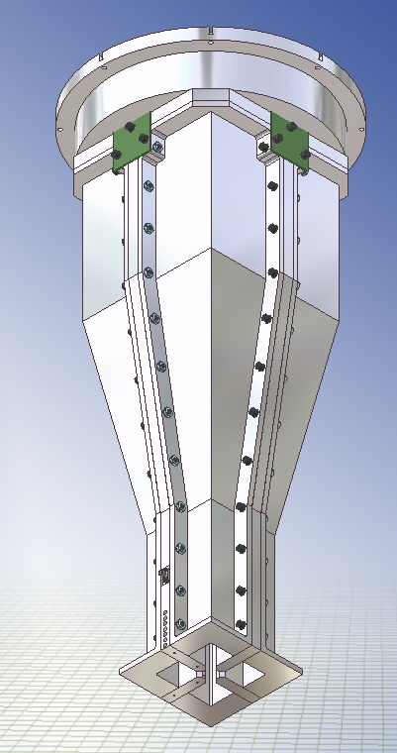
Septum Polarizer, Quadridged OMT
Septum Polarizer Length ~ 3.75" (2.7λ); BW ratio 1.28:1
L-band Quadridged OMT scaled to 8 to 12 GHz; Length = 3.975" (3.4λ)
BW ratio 2:1

Slide 5
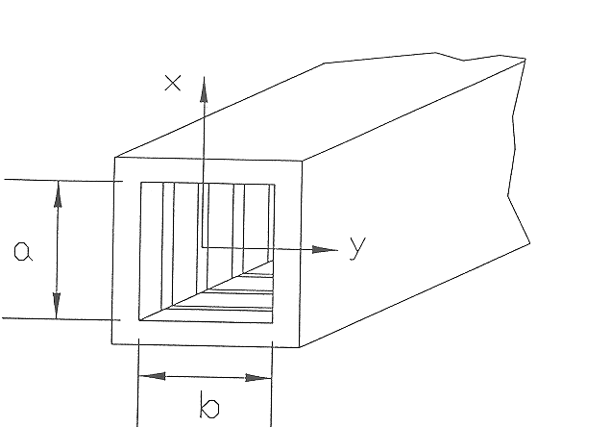
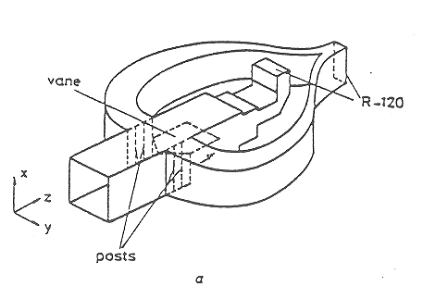
Boifot Junction OMT
Lengths:
Circular-square transition = 2.318”
Phase shifter = 7.875" (6.67λ)
45 twist = 3.454"
Boifot OMJ = 6.400" (5.4λ)
Total = 20.047”
(OMJ scaled from Ka-band)
BW ratio ~1.5:1

Slide 6

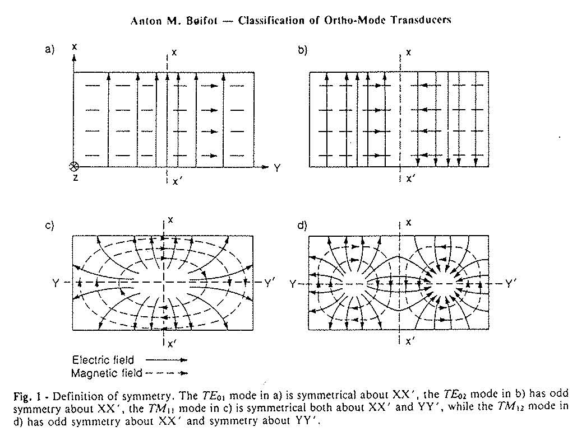


Symmetrical and Odd-symmetrical modes
f_{c}= 6.557 GHz
f_{c}= 13.114 GHz
TE₀₁
TE₀₂
f_{c}= 16.145 GHz (rect.)
f_{c}= 9.272 GHz (sqre.)
f_{c}= 19.739 GHz (rect.)
f_{c}= 14.662 GHz (sqre.)
TM₁₁
TM₁₂

Slide 7
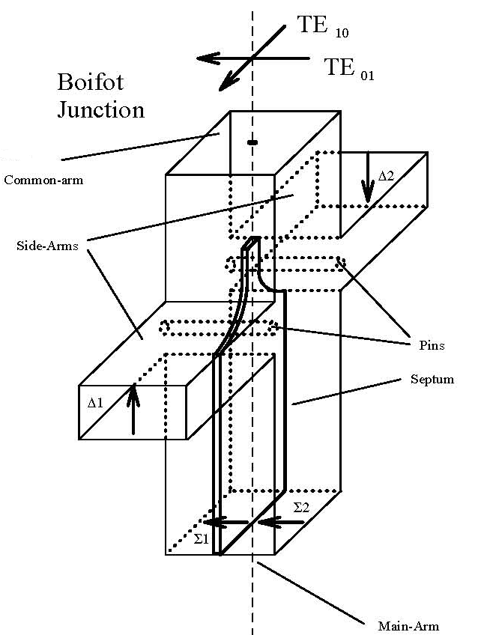
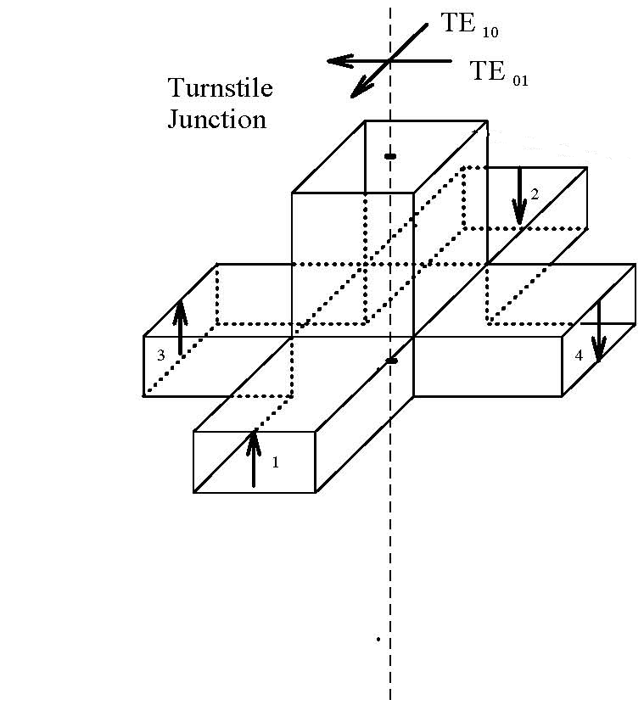
Turnstile Junctions
TM₁₁
x'
x

Slide 8
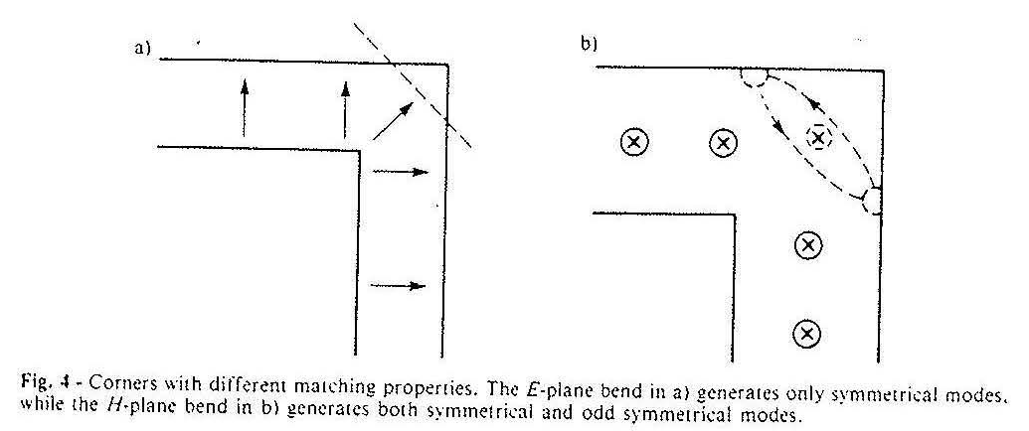
E-plane, H-plane bends
E
E

Slide 9
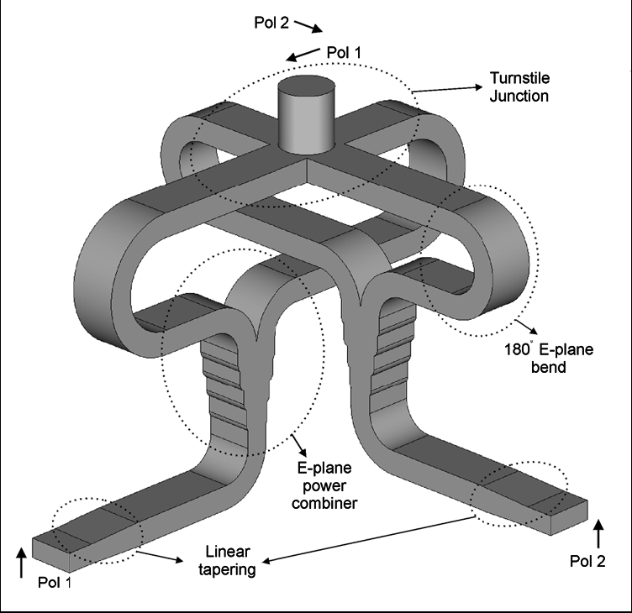
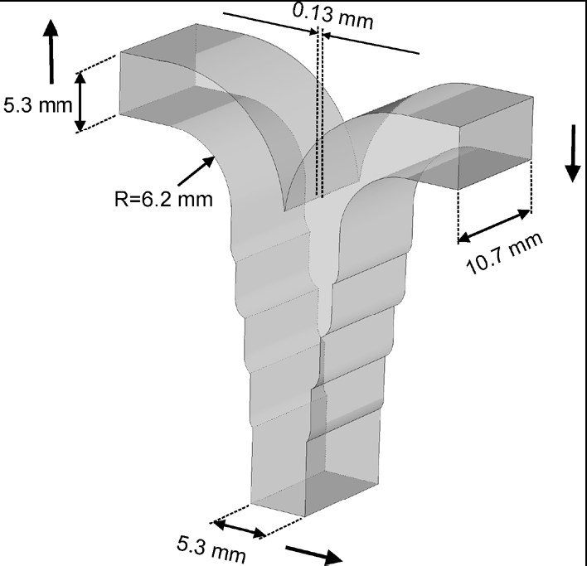
A Turnstile Junction Waveguide Orthomode Transducer
A. Navarrini and R. L. Plambeck
18-26 GHz; Circ. Dia=0.457 "; Waveguide=0.420"x0.208"; Stub: 0.173"x0.173"x0.087";Prototype for 210 to 270 GHz
S₁₁< -23 dB (Turnstile jn.) ; S₁₁<-32 dB (combiner) ; Linear taper to 0.420"x0.170" – S₁₁<-33 dB
IEEE Transactions MTT, Jan 2006

Slide 10
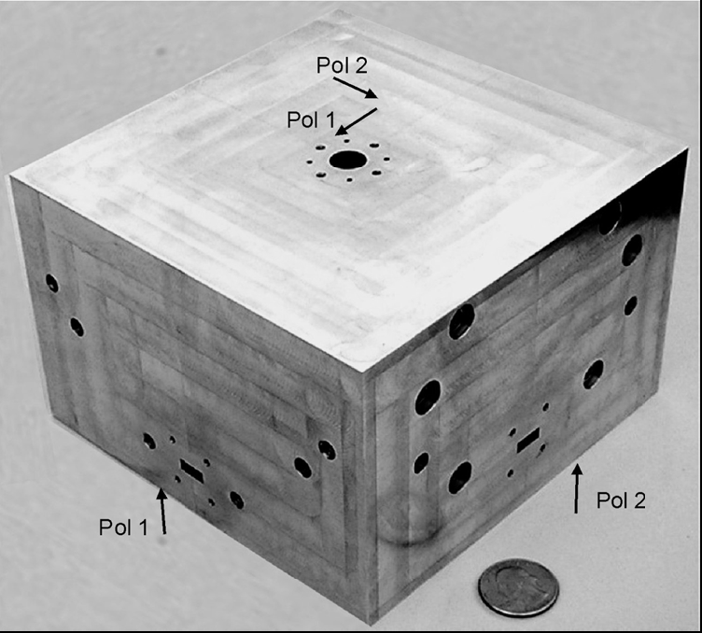
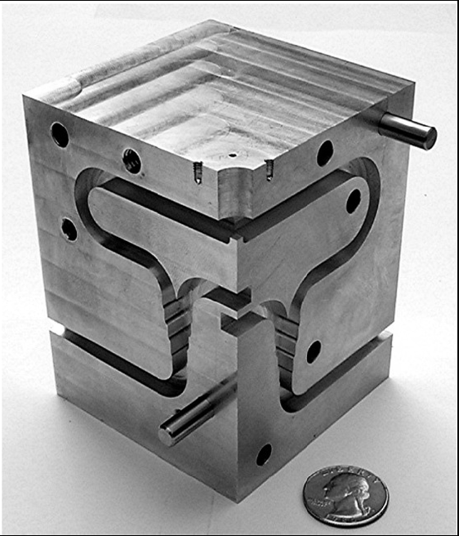
A Turnstile Junction Waveguide Orthomode Transducer
A. Navarrini and R. L. Plambeck
Split in E-planes; Path length = 9.84" (25 cms); External dim: 5.8"x5.8"x3.8"

Slide 11
A Turnstile Junction Waveguide Orthomode Transducer
A. Navarrini and R. L. Plambeck
S11< -19 dB; S21 ~ -0.15 dB; Isolation <-48 dB; (over 1.44:1 BW)
Scaling to X-band 13"x13"x8.5"

Slide 12
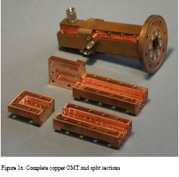
Double Ridged Orthogonal Mode Transducer for the 16-26 GHZ Microwave Band
Alex Dunning
Split planes perpendicular to ridges
9 steps for TE01; Ridge t=0.055”
NOT SYMMETRICAL; All modes except TE10 cut off in Rect. Wg.

Slide 13
Double Ridged Orthogonal Mode Transducer for the 16-26 GHZ Microwave Band
Alex Dunning
S₁₁ <-25 dB; Isolation <-40 dB; Insertion loss < -0.25 dB (frnt); <-0.20 dB (rear) over 1.6:1 BW
Length = 3.4” (16 – 26 GHz)
Scaling to X-band L=7.3”

Slide 14
Ultra-Thin Broadband OMT with Turnstile Junction
Y. Aramaki, N. Yoneda, M. Miyazaki and T. Horie
Mitsubishi Electric Corporation
Ku-band (10-15 GHz)
Circ. To Sq. transition – dia : 0.945", I step: 0.748"x0.748", II step: 0.630"x0.630 "
Turnstile Jnc.- Rect. Waveguide 0.630"x0.315", Pyrmd. Stub 0.394"x0.394"x0.275"
Combiner – E-pln stepped imp. Transformer, H-pln bend, E-pln T-junction 0.630"x0.236“
(h=0.315 t0 0.118)
2003 IEEE MTT symp. Digest

Slide 15
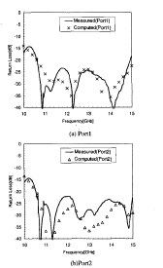
Ultra-Thin Broadband OMT with Turnstile Junction
Y. Aramaki, N. Yoneda, M. Miyazaki and T. Horie
Mitsubishi Electric Corporation
S₁₁ : Turnstile jnc. with stub <-14 dB (10-15); <-20 dB (11.5-15)
Turnstile jnc. with stub + Cir. To sq. step <-20 dB (10-15)
OMT S₁₁ <-22 dB (11-15); <-15 dB (10-15)
Insertion loss <0.1 dB
Isolation better than -40 dB
Height from bottom of II step to bottom of combiner = 0.800"; Cross-section dia ~ 5.5"
Scaling to X-band : Ht = 1.000"; Dia = 7.0"

Slide 16
Optimization Of Components Of The OMT
1. Turnstile Junction
2. Side arms with waveguide bends
3. 0.900x0.400 to 0.900x0.180 stepped transformer
4. Y-Junction
5. 0.900x0.380 to 0.900x0.400 stepped transformer
Used CST Microwave Studio in all the optimization and analysis

Slide 17
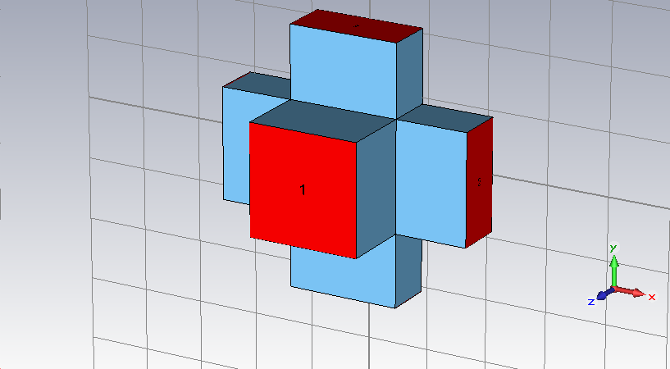
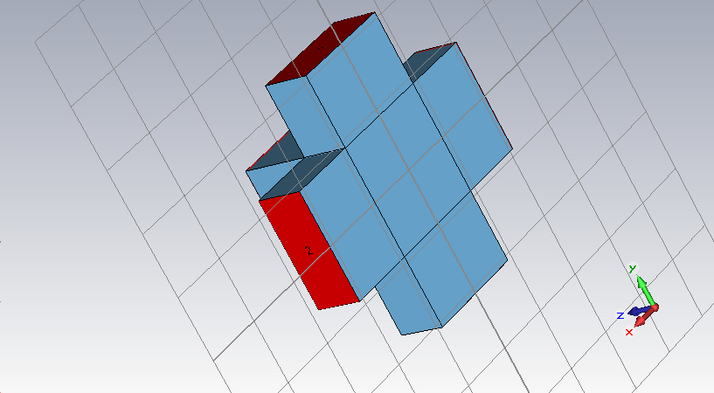
Turnstile Junction

Slide 18
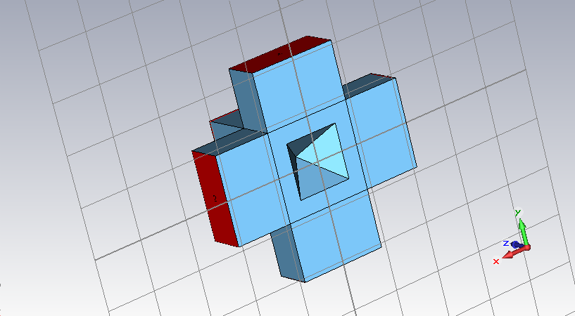
Turnstile Junction with pyramidal stub
side pyh
b08b 0.562 0.394*
b08 0.562 0.373
S₁₁≤ -17.9

Slide 19
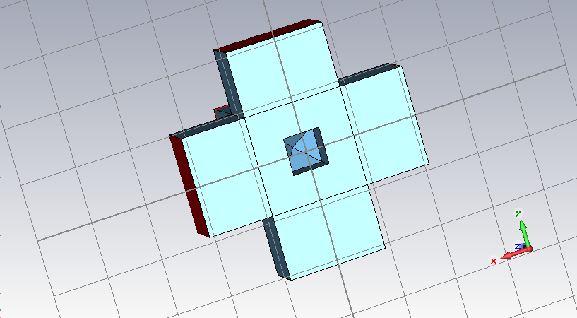
Turnstile Junction with square prism + pyramid stub
side h pyh
b02 0.335 0.210 0.200
b04 0.335 0.210 0.100
b06 0.300 0.210 0.090
b08a 0.335 0.210 0.030
S₁₁ ≤ -21.4

Slide 20
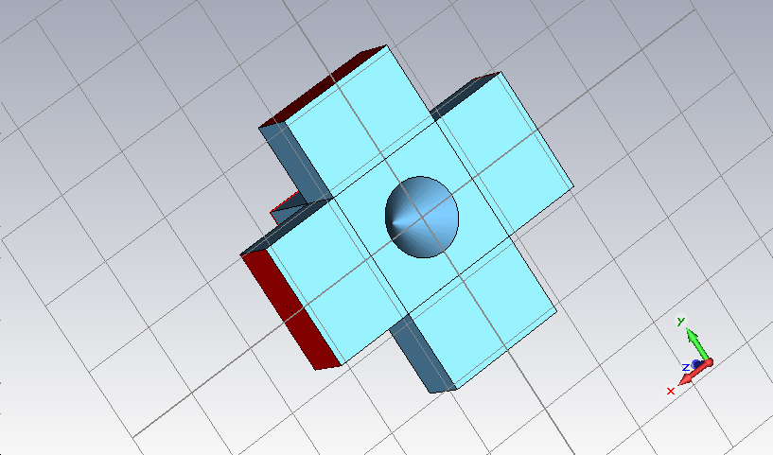
Turnstile Junction with conical stub
dia ht
d01 0.530 0.445
d02 0.510 0.445
d03 0.550 0.450
S₁₁≤ -20.0

Slide 21
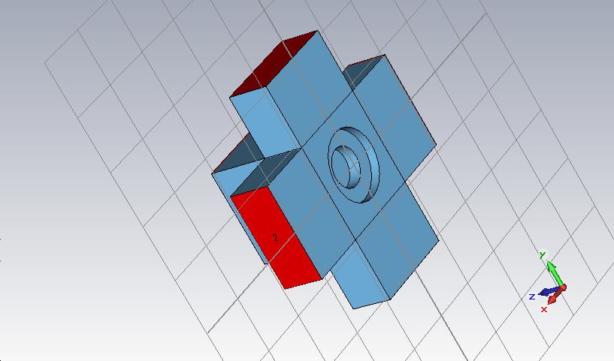
Turnstile Junction with 2 cylinders
D H d h
c01 0.705 0.096 0.325 0.184*
c02 0.635 0.086 0.358 0.202
S₁₁ ≤ -9.4

Slide 22
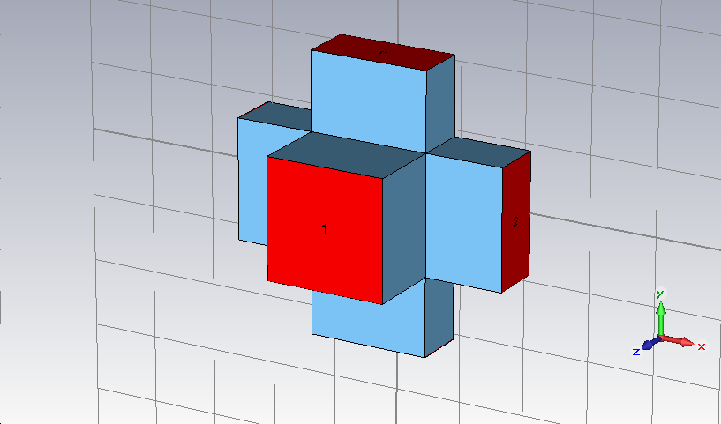
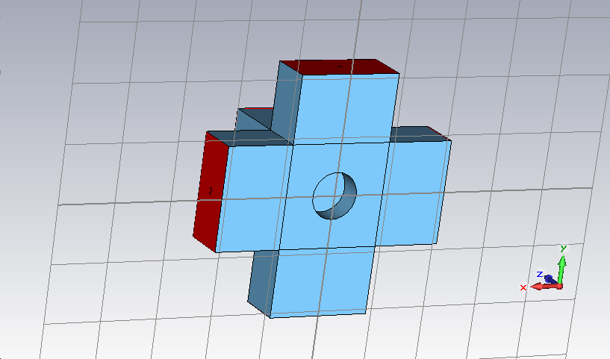
Turnstile Junction with cylindrical stub
Dia. Ht.
co4 0.385 0.217
c05d 0.405 0.195
c06 0.405 0.200
c07 0.396 0.207
S₁₁ ≤ -21.5

Slide 23
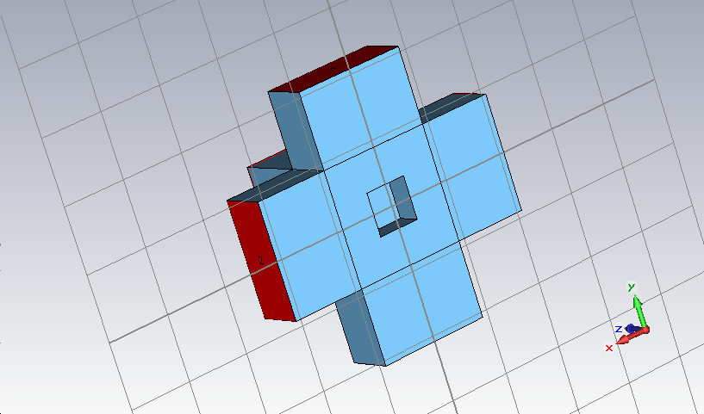
Turnstile Junction with square prism
side ht
08e 0.371 0.186 *
08j 0.363 0.190
08l 0.355 0.200
08n 0.345 0.200
08r 0.335 0.210 **used this design
S₁₁ ≤ -21.6

Slide 24
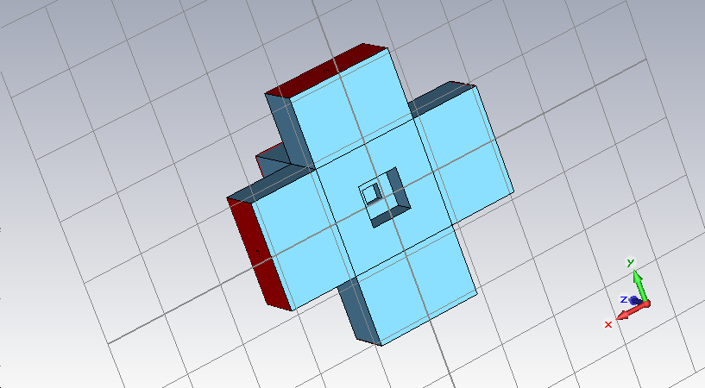
Turnstile Junctions with 2 square prisms
s1 h1 s2 h2
a01 0.335 0.210 0.128 0.080
a02a 0.348 0.192 0.128 0.080
a02b 0.346 0.195 0.134 0.076
S₁₁ ≤ -21.55

Slide 25
Waveguide Transformer & H-plane Bends in the side arm
Waveguide Transformer
0.900 x 0.400
to
0.900 x 0.180

Slide 26
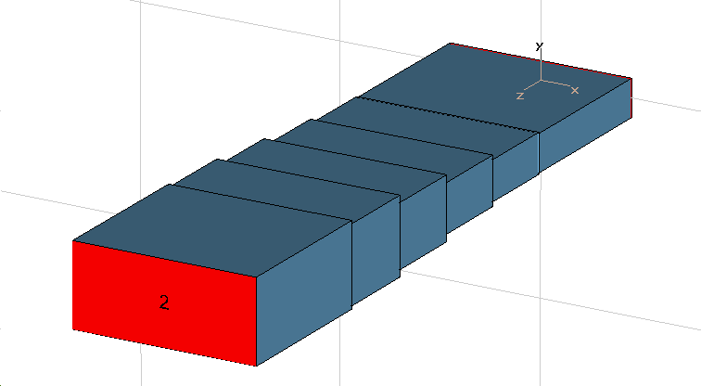
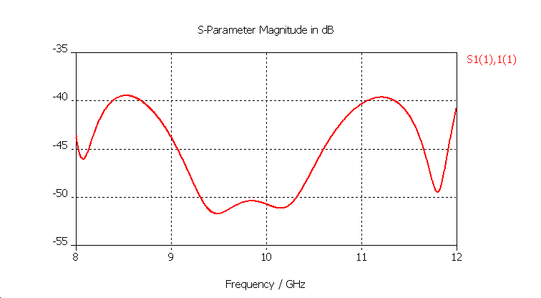
4-step Tchebyschev Transformer
λ_{g} = 1.6133”; λ_{g} /4 = 0.4033
0.180
0.192
0.234
0.397
0.304
0.396
0.371
0.400
0.399
0.408
0.900

Slide 27
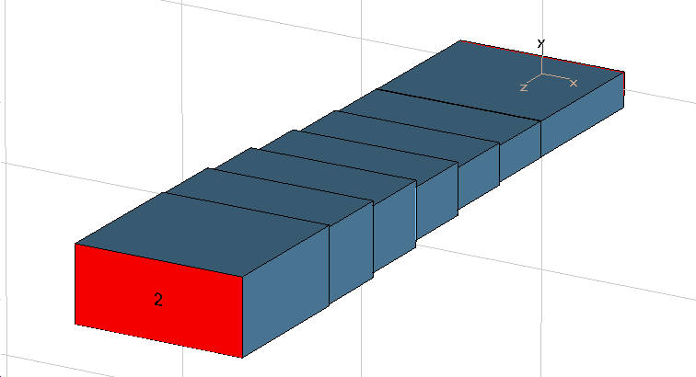
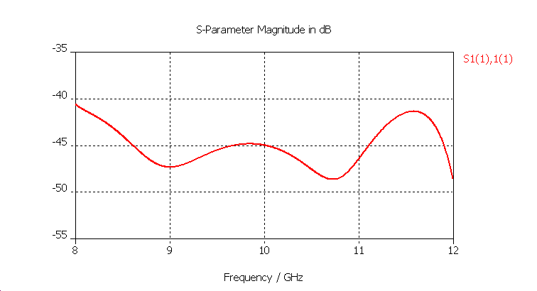
5-step Tchebyschev Transformer*
λ_{g} = 1.6133”; λ_{g} /4 = 0.4033
0.180
0.185
0.213
0.397
0.335
0.267
0.397
0.384
0.397
0.400
0.403
0.409
0.900
*Used this design

Slide 28



H-plane bend
**
(1)
where
(2)
For a given |ρ| and λg, l is given by
(3)
a=0.900 and λg=1.6133
l=0.105λ_{g} or l=[0.105+(n/2)] λ_{g}
For n=3, l=2.589; R=1.648
** F.C. de Ronde, “Full Band Matching of Waveguide Discontinuities”, IMS, Palo Alto, CA 1966

Slide 29
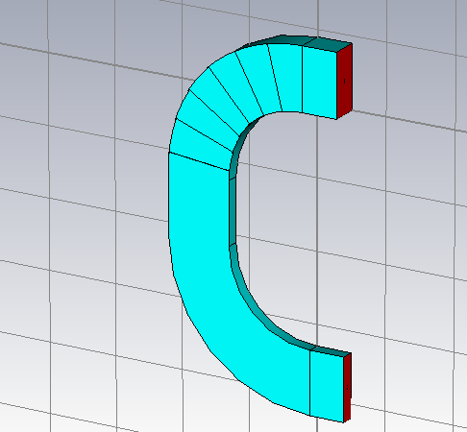
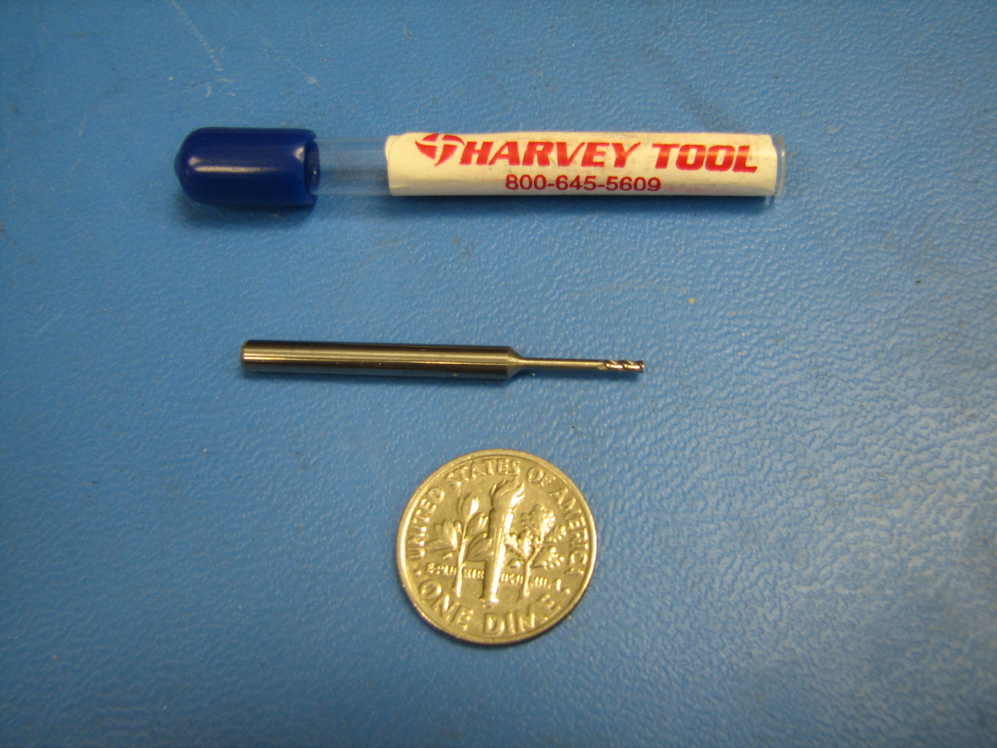
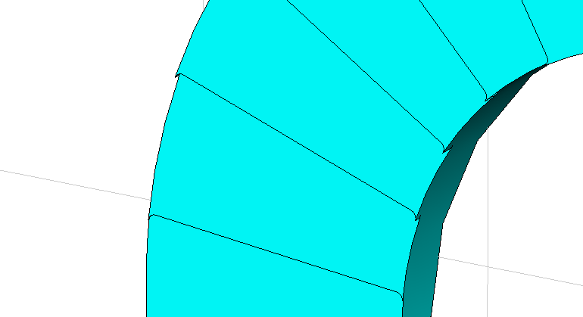
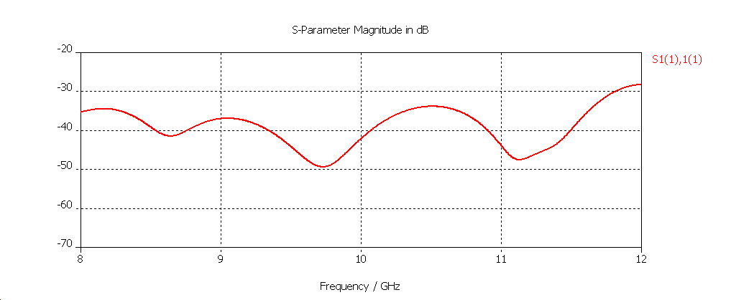
H-plane bend with stepped transformer
R
Cutting tool
Radius=0.0235
Length=0.470
R x π/2 = l
l = 1.605 λ_{g} ; R=1.6484”

Slide 30
E-plane Y-Junction
Y-junction
Input: 0.900x0.180
Output: 0.900x0.380
0.900x0.390
0.900x0.400

Slide 31
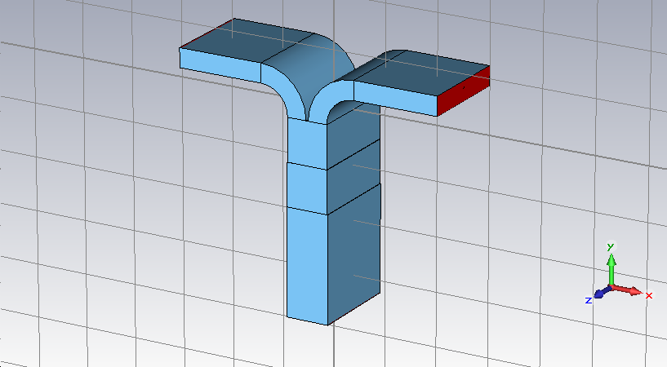
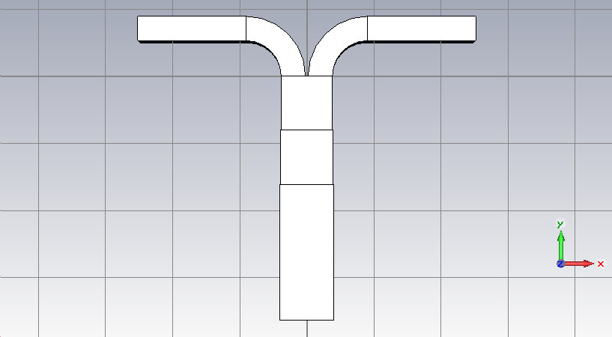
E-plane Y-junction
R
Xc
R Xc
7 0.450 0.640
7b 0.450 0.640 0.380 to 0.400
7f 0.450 0.640 0.380, 0.390, 0.400
8a 0.260 0.450 0.380, 0.390, 0.400
S₁₁ ≤ -32.6

Slide 32
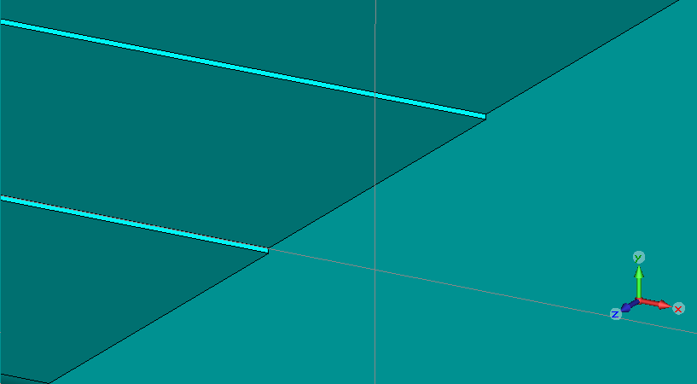
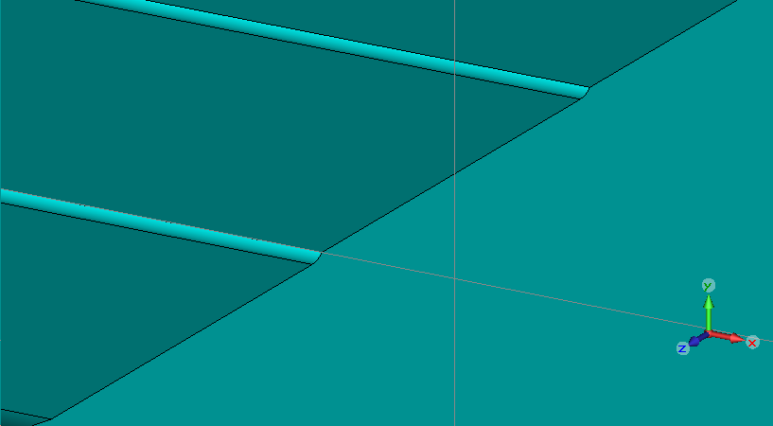
E-plane Y-junction
5aa1: No radius on steps
6aa1: 0.0235 radius
S₁₁ ≤ -32.6

Slide 33
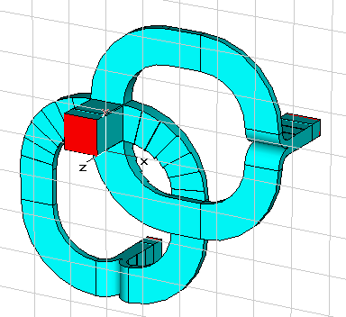
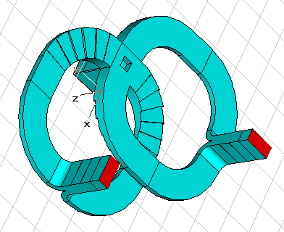
CST Microwave Studio Model
Port 1
Mode 2
Port 3
Mode 1
Port 3
Port 2
Port 2

Slide 34
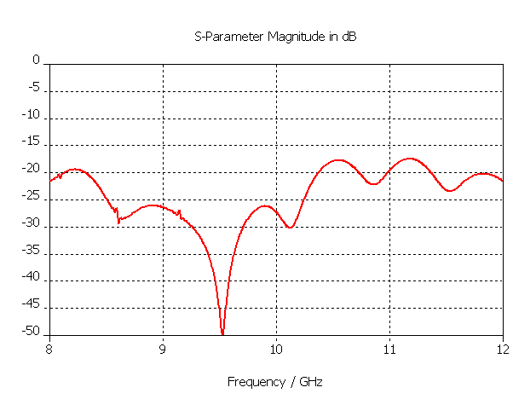

Input Return Loss
S1(1),1(1)
S1(2),1(2)
S₁₁<-17.4 dB

Slide 35
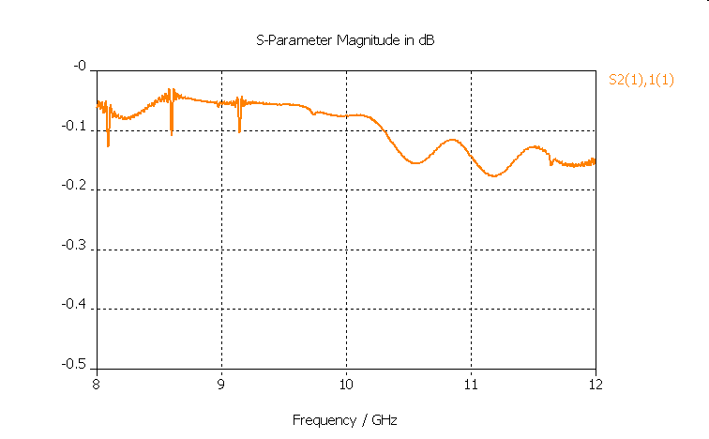
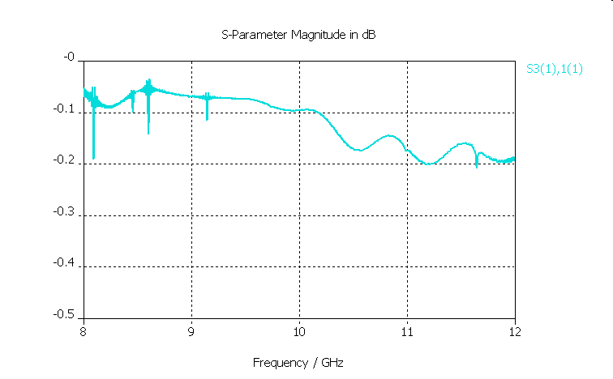
Insertion Loss
S2(1),1(1)
S3(1),1(2)

Slide 36
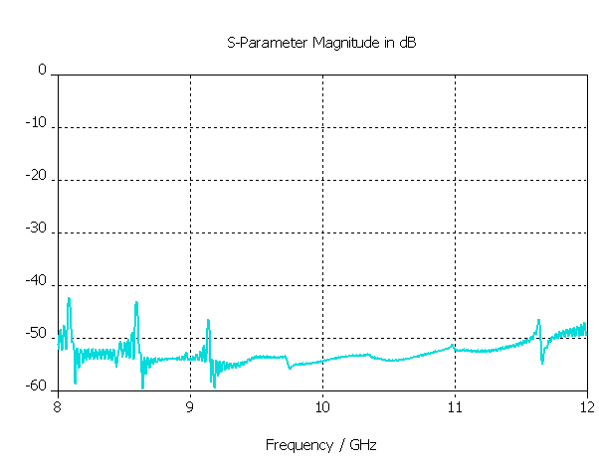
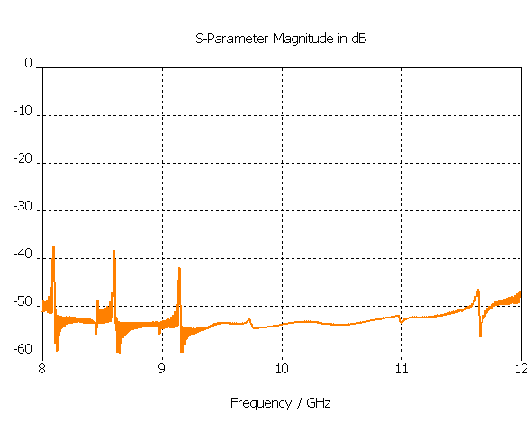
Crosspolarization
S3(1),1(1)
S2(1),1(2)

Slide 37
Mechanical Design
Cross-section 9.25”; Height 2.68”; Measured weight : 4.4 lbs

Slide 38
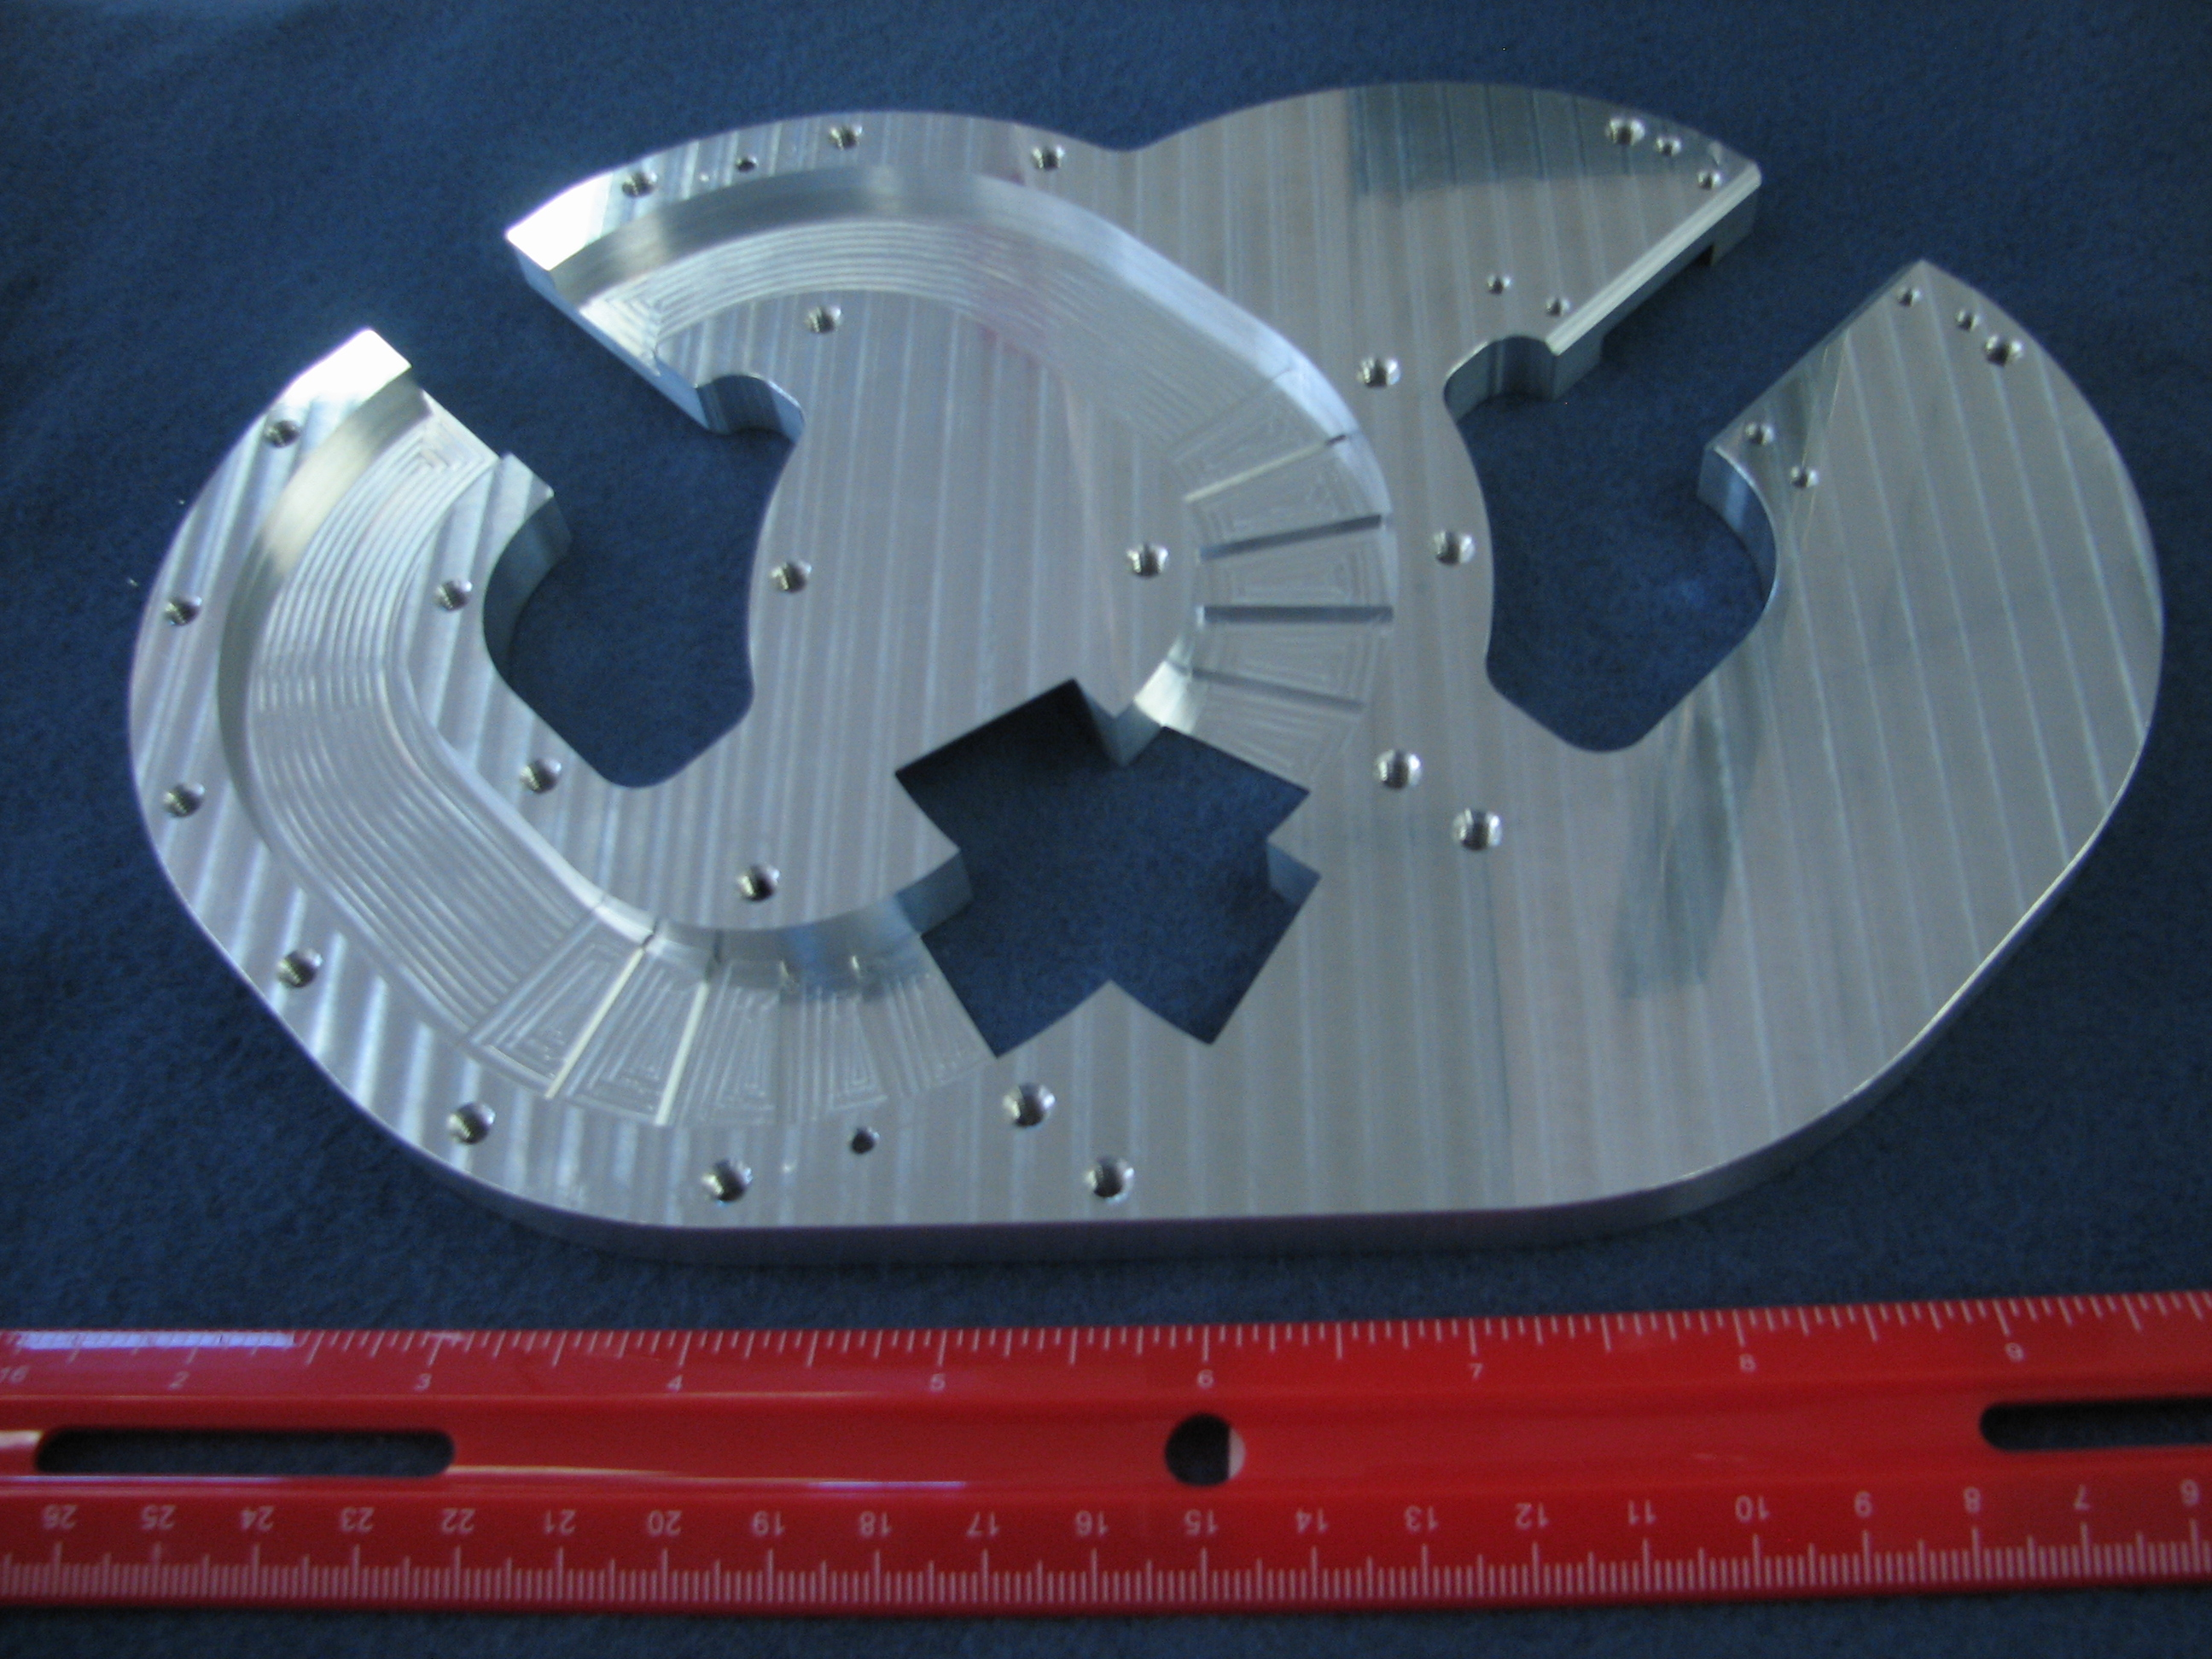
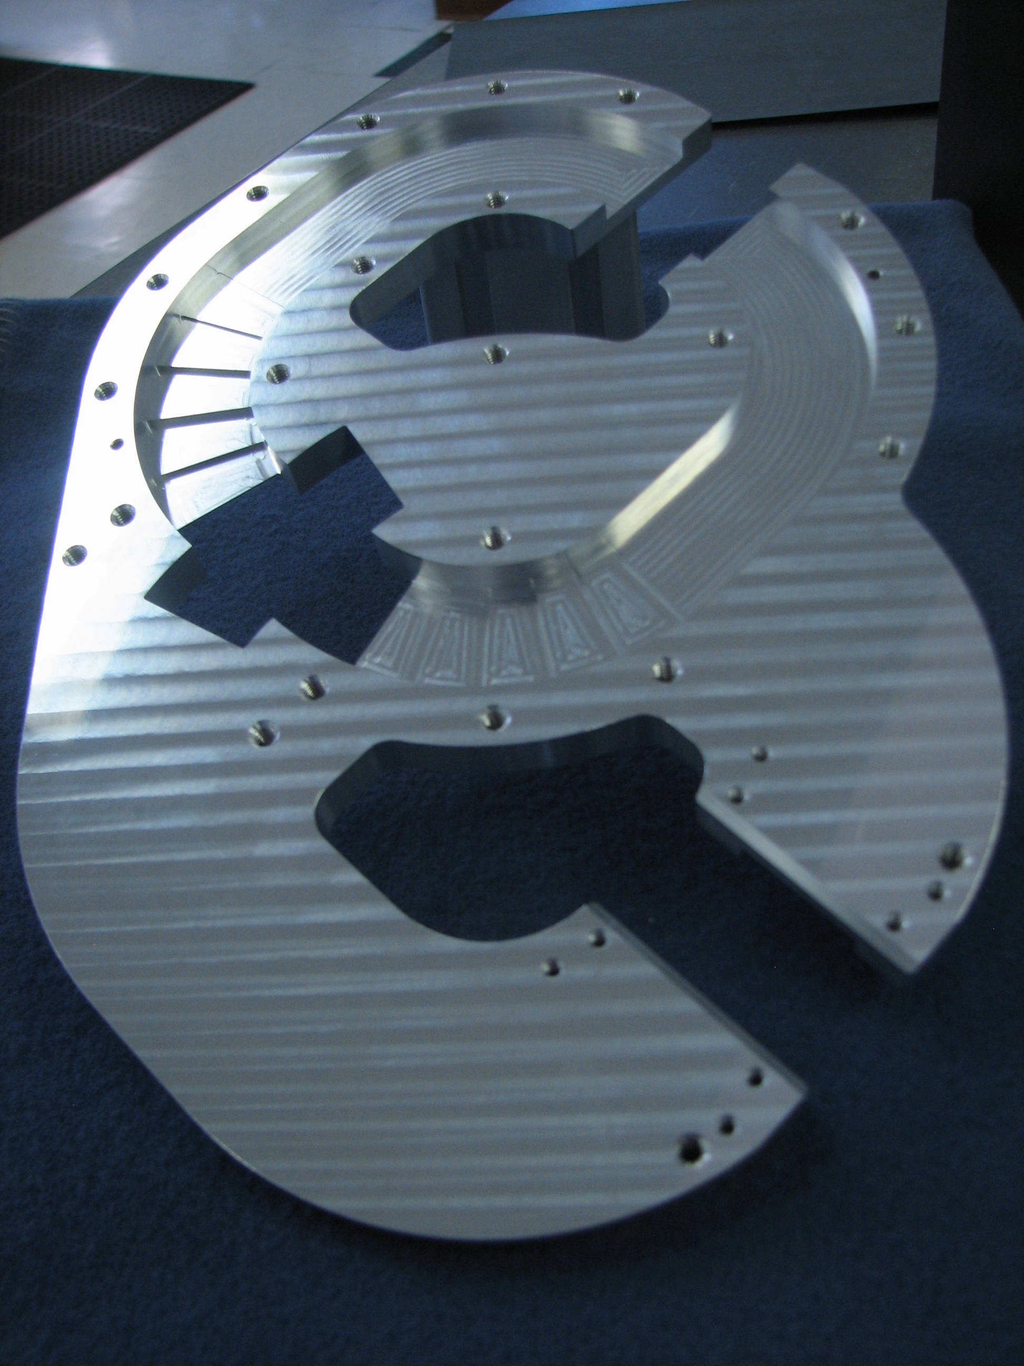
Center plate with curved stepped transitions
Side arms with bends and stepped transformer

Slide 39
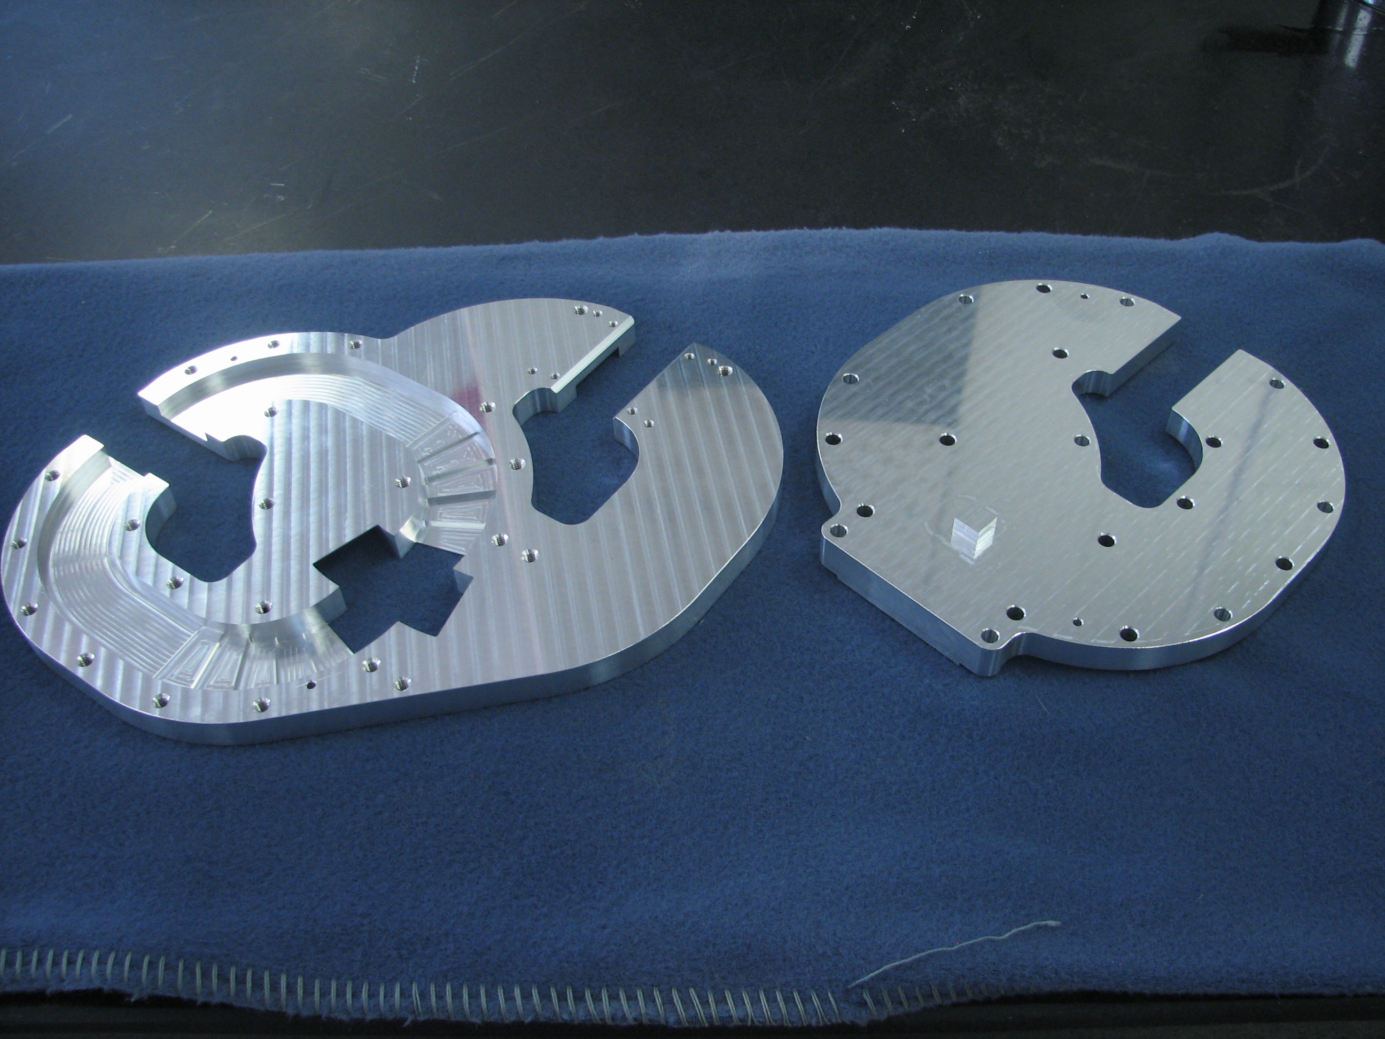
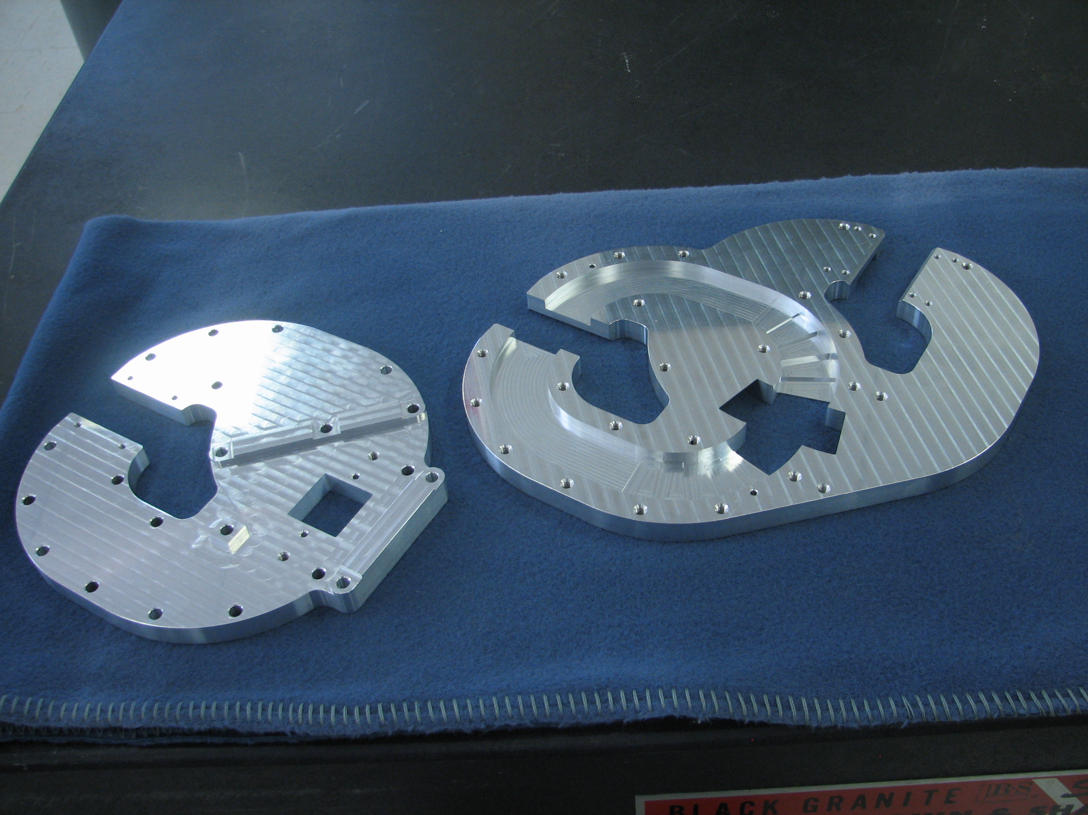
Bottom and top plates
Bottom plate with square tuning stub
Top plate with input waveguide

Slide 40
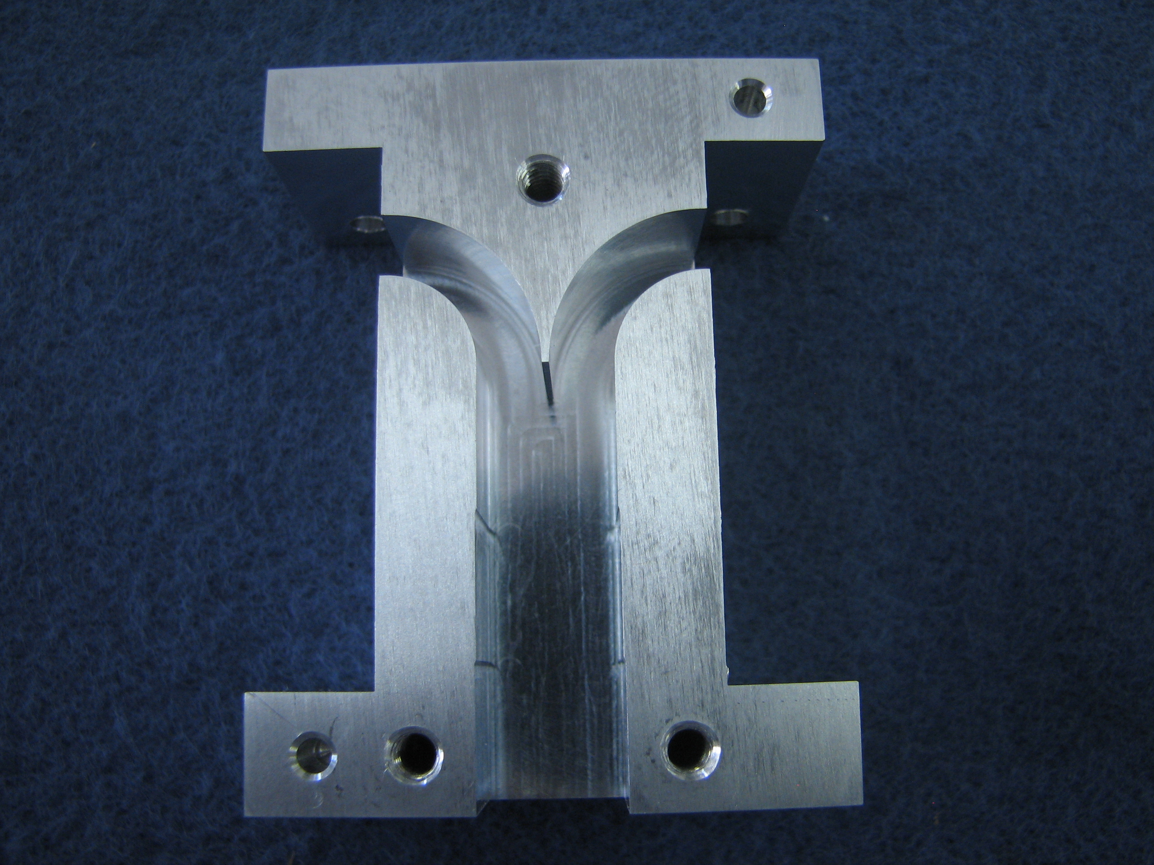
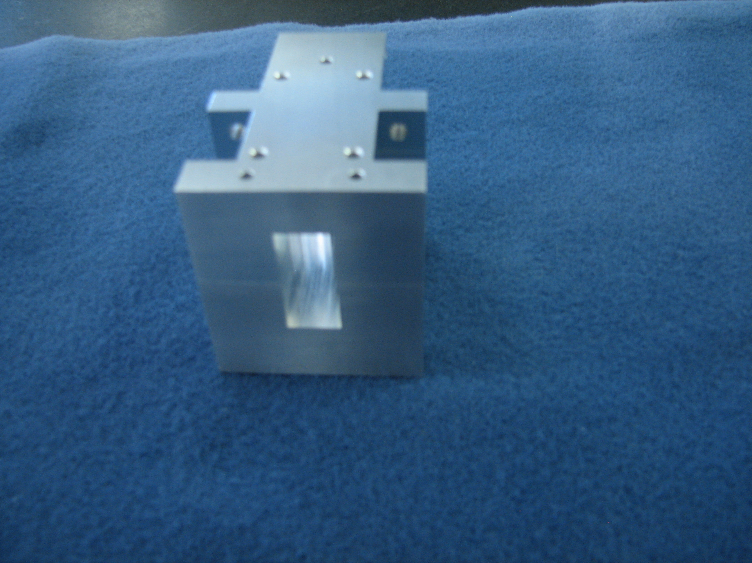
E-plane Y-Junction
E-plane split block
Assembled Y-Junction
Input 0.900x0.180; Output at junction 0.900x0.380
Inner radius 0.260; Outer radius 0.440; Center 0.450

Slide 41
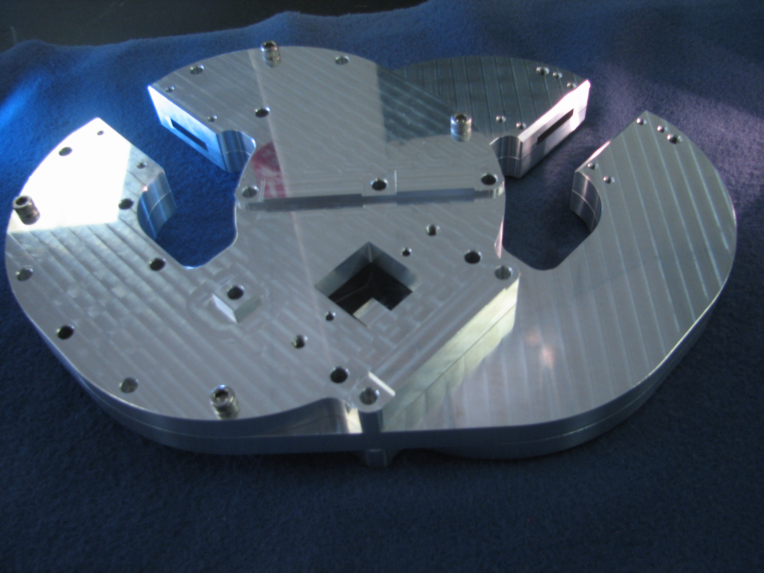
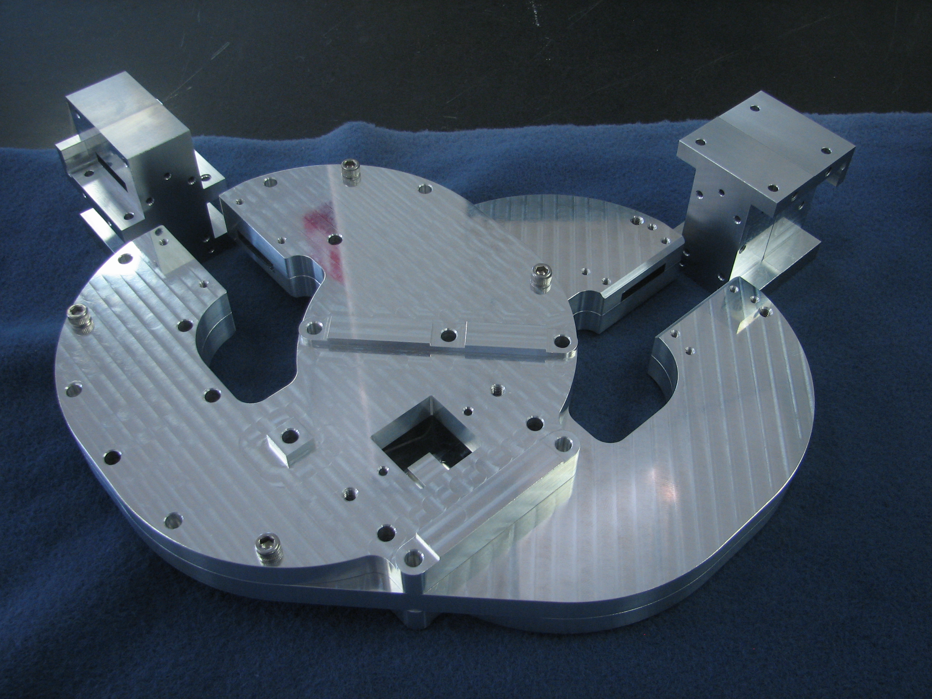
Assembly
Main body assembled
Main body, output ports

Slide 42



Assembled OMT
Square port
Rectangular ports

Slide 43


Measurement
Measurements with Agilent N5245A PNA-X

Slide 44

S₂₂ and S₁₂-Port 2
S₂₂<-18.7 dB

Slide 45

S₃₃ and S₁₃-Port 3
S₃₃<-18.3 dB

Slide 46

Measurement of S₁₂ after pinning

Slide 47
Measurement of S₁₃ after pinning

Slide 48


Crosspolarization

Slide 49


Isolation between ports

Slide 50



Jillian Michaels Weight Loss Program
Recess 0.100” deep
↓
Thru’ tapped holes
↓
↑
Metal cut away
Version 1
Weight: 4.39lbs
Dia 9.25”; Ht 2.68”
Pins
Version 2
Weight: 2.55lbs
Dia 9.18”; Ht 2.68”

Slide 51
More compact design
0.900
8.000
0.250
9.186
0.900
0.250
Version 2: 2.55 lbs
Version 3: 2.2 lbs

Slide 52

Performance of 9.25” & 8.0” OMTs (CST)
-17.4; -17.2dB

Slide 53
Performance of 9.25” & 8.0” OMTs (CST)

Slide 54
Layout of Polarizer components
2.32
7.88
3.45
8.000 dia
2.68
Total length=16.33

Slide 55
Conclusions
Full waveguide band (8-12 GHz) OMT has been realized
Returns loss > 18.3 dB; Insertion loss ~0.1dB; Crosspolarization ≤ -50 dB; Port to port isolation ~ -40 dB
Compact: Height 2.68”; Cross-section 9.25”;Weight 4.4lbs Version 3:Height 2.68”, Cross-section 8.00”;Weight 2.2 lbs
Fabrication easy; only machined parts
No pins, no septum; Sturdy construction (can withstand several ‘G’ acceleration)
Two fold symmetry; only symmetric higher order modes if any and will cancel at output ports
Coupling into amplifier in waveguide transmission line

Slide 56
Conclusions (continued)
Waveguide isolator has ~0.2 dB lower loss compared to coax isolator
Turnstile OMT ~0.1 dB lower loss compared to Quadridged OMT (due to coax connector)
Loss due to 8 & 9 will contribute to 1.1K lower T_{rx} at 15K physical temperature; ~5% of T_{rx} at X-band (3.6% of T_{sys})
Poor S₁₁ with coax connector may contribute to base line ripple.
Limiting factor with subject OMT is the turnstile junction.
Cost of OMT $861/piece for a lot size of 30 (J&E Precision Tool Inc., Southampton, MA)

Slide 62
Jillian Michaels Weight Loss Program
Recess 0.100” deep
↓
Thru’ tapped holes
↓
↑
Metal cut away
Pins
Weight: 4.39lbs
Dia 9.25”; Ht 2.68”
Weight: 2.55lbs
Dia 9.18”; Ht 2.68”

