Slide 1
Offset Quadruple-Ridge Orthomode Transducer, Mode Splitter/Combiner
X-Band OMT Design Review October 1, 2009
Gordon Coutts

Slide 2
Introduction

Slide 3
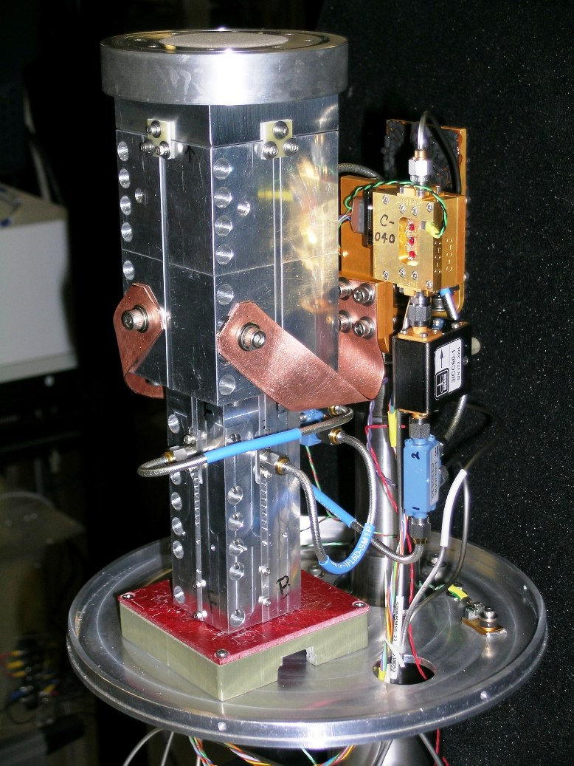
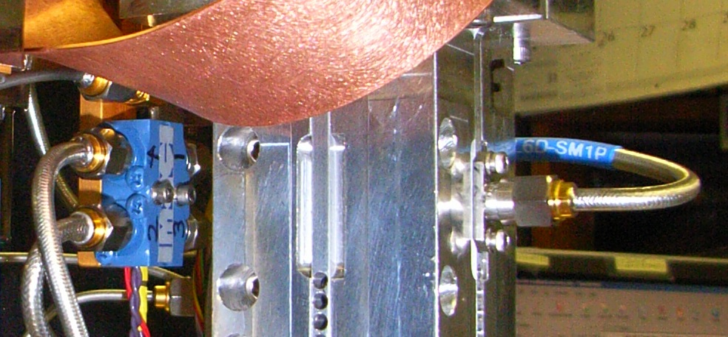
Low-Band EVLA Circular Polarizers
Circular to Square Transition
Quadruple-Ridge OMT (separates orthogonal linearly polarized signals)
Quadrature Hybrid
Phase-Matched cables connecting the OMT to the hybrid
Quadrature Hybrid

Slide 4
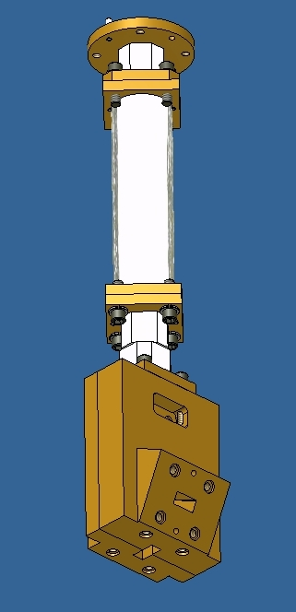
High-Band EVLA Circular Polarizers
Circular to Square Transition
Sri’s corrugated waveguide Phase Shifter
45 Degree offset mode splitter
Bøifot OMT (separates orthogonal linearly polarized signals)

Slide 5
X-Band Design Challenges
Two options using conventional technology from existing EVLA receivers:
  Cascaded Bøifot OMT/ mode splitter/ phase shifter
    This would scale to an impractically large size at X-band
  Direct scaling of the C-Band Polarizer to work at X-Band
    This would result in very small dimensions (20 mil chamfer, 30mil ridge gap)
    Manufacturing tolerances would be a significant percentage (of the order of 10%) of the scaled dimensions
    Narrow ridge dimensions would not readily accommodate set screws/coaxial feeds
    Phase matching to an external hybrid would be extremely difficult due to the required cable length adjustments (1.9mil/degree at 12GHz)

Slide 6
Proposed X-Band OMT Design

Slide 7
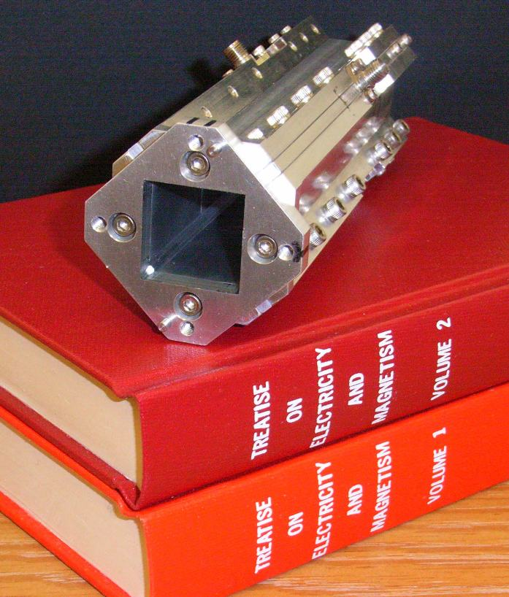
Novel X-Band OMT Design
The new X-Band OMT uses a 45 degree offset quadruple-ridge design
The novel polarizer design combines concepts from low-band and high band circular polarizer designs
The OMT combines the function of the ‘45 degree twist’ mode splitter and Bøifot OMT used in the high frequency designs

Slide 8
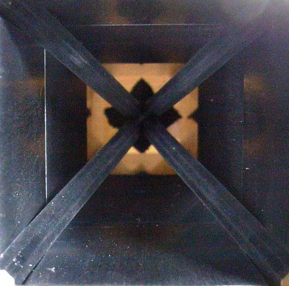
Novel X-Band OMT Design
Ridges are offset from the square waveguide input by 45 degrees
Square Waveguide Input: 0.947” x 0.947”
Detects circularly polarized signals when used in conjunction with Sri’s waveguide phase shifter
No external quadrature hybrid or phased matched cables in this design

Slide 9
High-Band EVLA Circular Polarizers
Circular to Square Transition
Sri’s corrugated waveguide Phase Shifter
45 Degree offset mode splitter
Bøifot OMT (separates orthogonal linearly polarized signals)

Slide 10
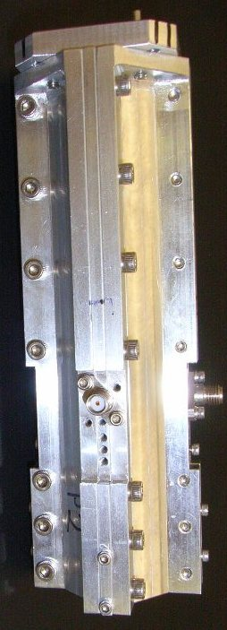
Proposed EVLA X-Band Circular Polarizer
Circular to Square Transition
Sri’s corrugated waveguide Phase Shifter
45 Degree offset quadruple-ridge OMT

Slide 11
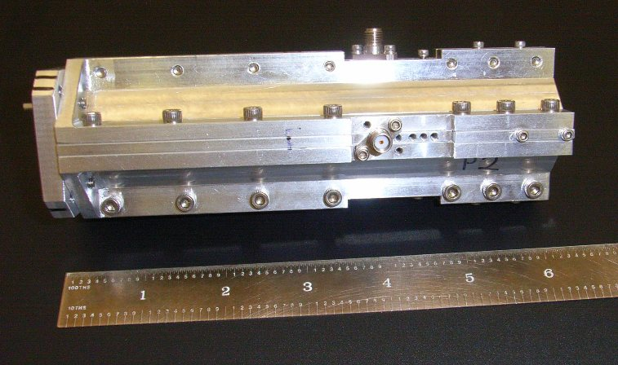
Compact Design of X-Band OMT
Compact design: OMT Length is 6.12”

Slide 12
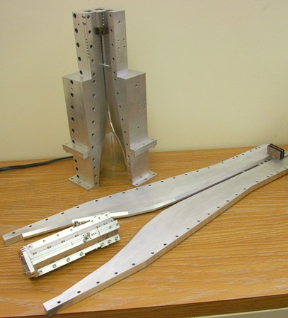
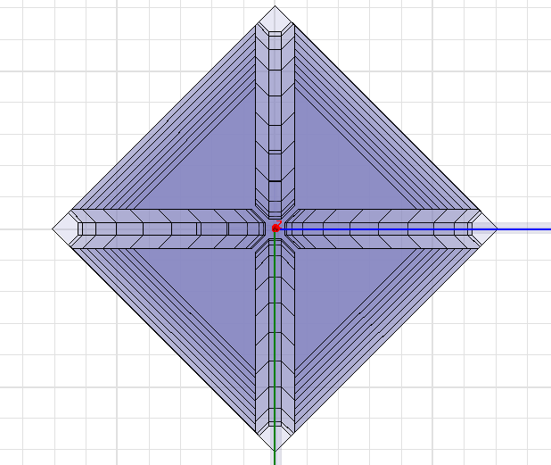
X-Band OMT Dimensions
Chamfer profile similar to C-band OMT for manufacturability
125 mil Ridge Width
62 mil Ridge Gap
40 mil Chamfer flat section
Locator block sets ridge gap and maintains symmetry

Slide 13
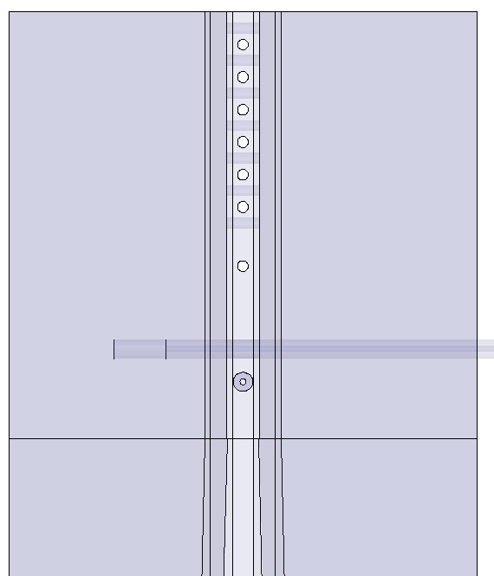
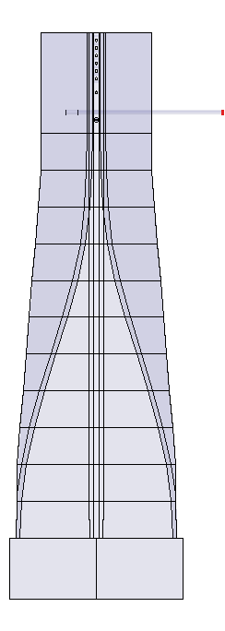
X-Band OMT Dimensions
The quadruple-ridge waveguide dimensions:
  optimum impedance at low-band edge
  Eliminate higher order modes
0.047” semi-rigid coaxial feeds
62.5mil spaced shorting pins for impedance matching and TE11 trapped-mode resonance suppression
One 2-56 set screw for each sorting pin, with set screws for adjacent pins on opposing ridges

Slide 14
Theory of Operation

Slide 15
Circularly Polarized Electromagnetic Waves
LCP (Astronomy Definition)
RCP (Astronomy Definition)

Slide 16
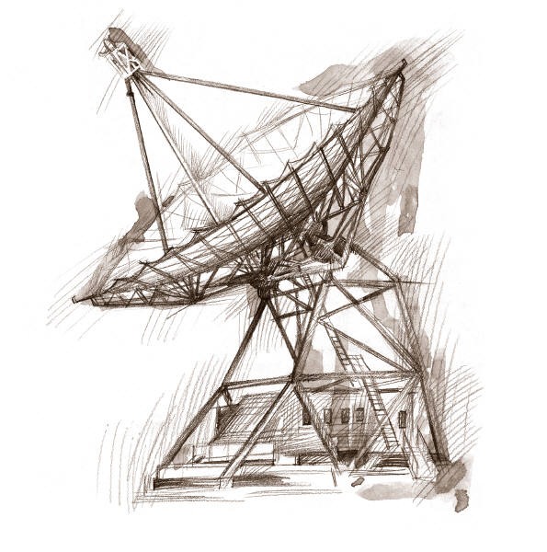
y
x
z

Slide 17
y
x
z

Slide 18
y
x
z

Slide 19
y
x
z

Slide 20
y
x
z

Slide 21
y
x
z

Slide 22
y
x
z

Slide 23
y
x
z

Slide 24
y
x
z

Slide 25
y
x
z

Slide 26
y
x
z

Slide 27
y
x
z

Slide 28
y
x
z

Slide 29
y
x
z

Slide 30
y
x
z

Slide 31
y
x
z

Slide 32
y
x
z

Slide 33
y
x
z

Slide 34
y
x
z
y
x
LCP signal

Slide 35
Theory of Operation
Apparent motion of electric field vector of circularly polarized electromagnetic waves as viewed from the receiver (astronomy definition).
y
y
x
x
LCP signal
RCP signal

Slide 36
Theory of Operation: Phase Shifter
Direction of
Propagation
Direction of
Propagation
y
y
x
x
LCP signal
RCP signal

Slide 37
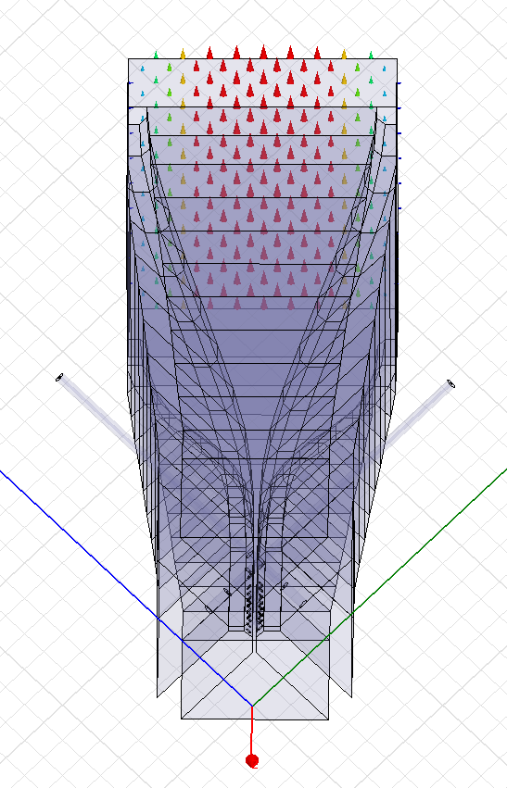
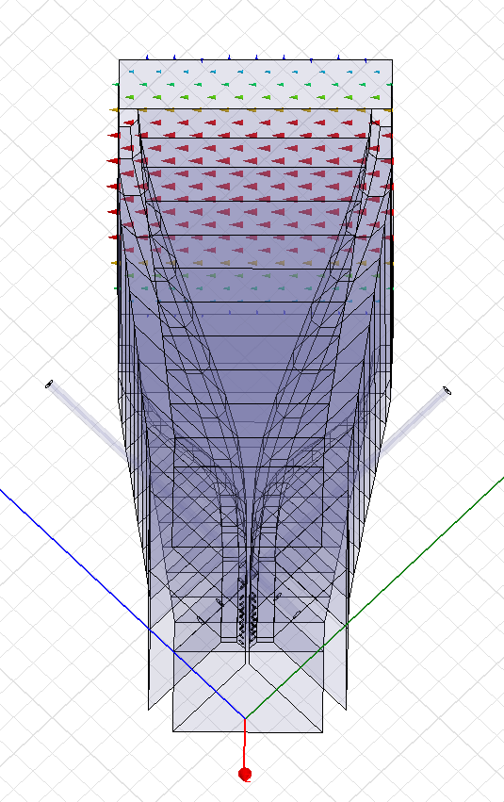
Theory of Operation: OMT
Port 2
Port 1
Port 2
Port 1
y
y'
x
x'
(mode 1)
(mode 2)

Slide 38
Theory of Operation: OMT
Port 2
Port 1
Port 2
Port 1
LCP signal output
RCP signal output
y
y'
x
x'
LCP signal
RCP signal

Slide 39
HFSS Simulated OMT Performance
HFSS simulated modal transmission S-parameter magnitude from OMT input to the coaxial OMT output ports

Slide 40
HFSS Simulated OMT Performance
HFSS simulated reflection OMT S-parameters

Slide 41
Measured X-Band OMT Performance

Slide 42
Measured OMT Performance

Slide 43
Measured OMT Performance

Slide 44
Measured OMT Performance

Slide 45
Measured OMT Performance

Slide 46
Measured OMT Performance

Slide 47
Measured OMT Performance

Slide 48
Measured Circular Polarization Performance using Machined Prototype Phase Shifters

Slide 49
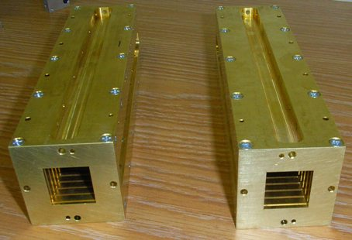
Machined Phase Shifters
Prototype X-Band phase shifters were fabricated in-house
Used to evaluate circular polarization performance of the new X-Band OMT
The X-Band OMT was connected to the phase shifter and measured using the PNA

Slide 50
Machined Phase Shifter Measured Performance

Slide 51
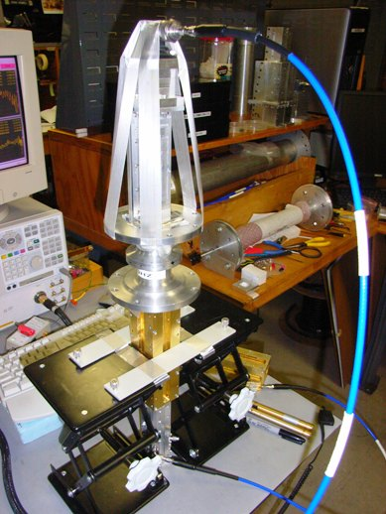
Measured Axial Ratio Performance

Slide 52
Circular Polarization Performance

Slide 53
Circular Polarization Performance

Slide 54
Measured Circular Polarization Performance using Scaled Ku-Band Phase Shifter Experimental Data

Slide 55
Scaled Phase Shifter Performance

Slide 56
Measured Axial Ratio Performance using Scaled Ku-Band Phase Shifter Data

Slide 57
Circular Polarization Performance

Slide 58
Circular Polarization Performance

Slide 59
Circular Polarization Performance using Measured OMT Data and Ideal Phase Shifter

Slide 60
OMT Contribution to Axial Ratio

Slide 61
OMT CP Insertion Loss

Slide 62
OMT CP Isolation

Slide 63
Conclusions
A novel 45 degree offset quadruple-ridge OMT design is proposed for the new EVLA wideband X-Band receivers
Two prototypes have been fabricated and tested, and exceed specifications by a wide margin
The compact design is amenable to cooling with a Model 22 refrigerator
Measured results show that the novel design exhibits good axial ratio and circular polarization performance
As with the other EVLA quadruple-ridge OMT designs, the new X-Band design is focused on excellent performance, ease of tuning and manufacturability
The OMT electromagnetic design is ready for production

